Slide 1
IPL DATA ANALYSIS
Presented By:
Mohammed Uvez K

Slide 2
Introduction
The Indian Premier League (IPL) is one of the most popular T20 cricket leagues worldwide, attracting massive audiences and involving intense competition among teams. This project aims to analyze a dataset of IPL matches and players to uncover trends, patterns, and key performance metrics. By leveraging data analysis techniques, we can gain valuable insights that are beneficial for teams, coaches, analysts, and fans.

Slide 3
Objectives
The primary objectives of this project are:
To explore and understand the various features of the IPL dataset.
To perform data preprocessing, including handling missing values and outliers.
To identify key factors that influence match outcomes and player performances.
To build predictive models that can forecast match results based on past data.
To visualize results and present actionable insights.

Slide 4
About the Dataset
Source: The dataset is sourced from Kaggle and contains IPL match data across multiple seasons, including features like team names, match scores, player statistics, and match outcomes.
Features: Key features include match date, team names, scores, player performance metrics, toss decisions, match outcomes, and venues.
Dataset Purpose: Helps analyze patterns in wins, player contributions, toss impacts, and venue influences on match outcomes.

Slide 5
METHODOLOGY
Data Collection: The dataset will be sourced from Kaggle, ensuring it is well-documented and reliable.
Exploratory Data Analysis (EDA): Handle missing data using imputation techniques, Summarize the dataset using descriptive statistics and Create visualizations (e.g., histograms, box plots, correlation heatmaps) to understand feature distributions and interactions.
Modelling: Split the dataset into training and testing subsets. Train various models (e.g., Logistic Regression, Decision Trees, Random Forest, etc.) and assess their performance using metrics such as accuracy, precision, recall, and F1-score. Optimize hyperparameters to enhance model performance.
Evaluation and Interpretation: Compare model performances and select the best-performing model. Interpret results to comprehend the impact of different features on fraud detection.
Visualization: Generate visual representations of findings to support conclusions.
Reporting: Compile analysis, results, and insights into a detailed report.

Slide 6
TOOLS AND TECHNOLOGIES
Programming Language: Python
Libraries: Pandas, NumPy, Matplotlib, Seaborn, Scikit-learn
IDE: Jupyter Notebook or any Python-compatible IDE
Data Source: Kaggle (IPL Dataset)

Slide 7
EXPLORATORY DATA ANALYSIS (EDA)
Importing Libraries: Import essential libraries for data manipulation and visualization.
Loading Dataset: Load the dataset containing anonymized features and transaction classes.
Basic Exploration: Use head(), tail(), shape, and info() to explore dataset structure and summary.
Checking Missing Values: Identify potential missing data issues with isnull().sum().
Descriptive Statistics: Obtain statistics like mean and quartiles with describe().
Identifying Duplicates: Check for duplicate transactions using duplicated().any().
Analyzing Class Distribution: Assess class balance with groupby('Class').mean().

Slide 8
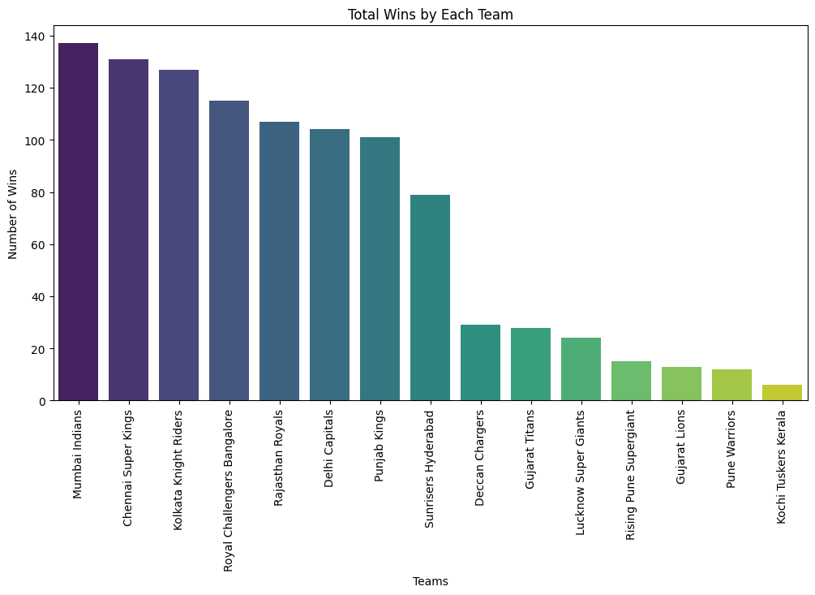
ANALYSIS QUESTIONS
Which team has the most wins?

Slide 9
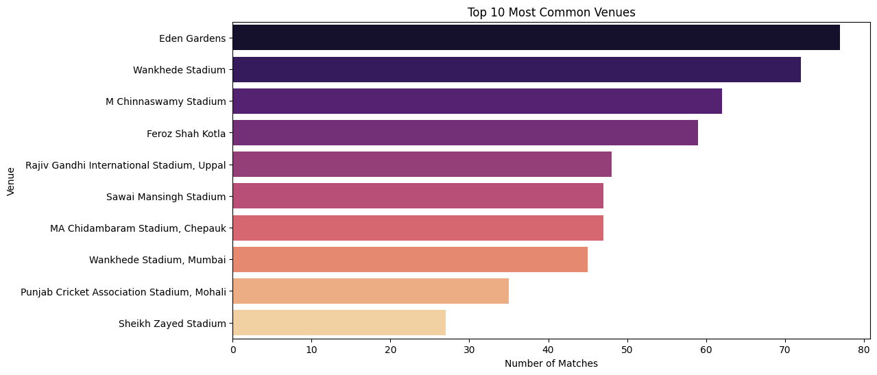
What are the most common venues for matches?

Slide 10
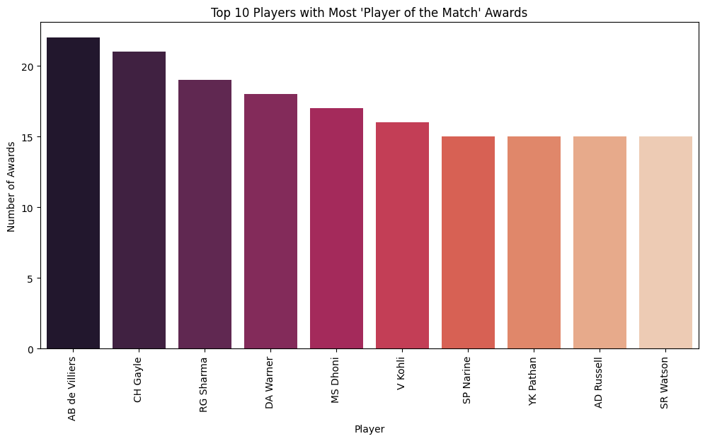
Who are the most frequent "Player of the Match" awardees?

Slide 11
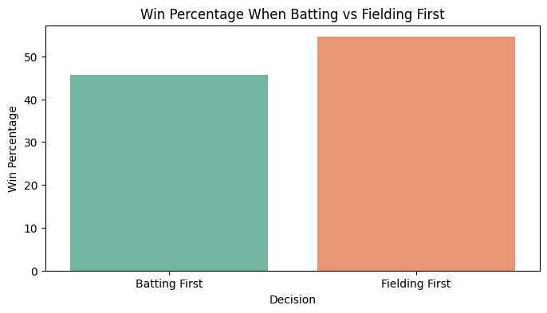
Is there a difference in win percentages when batting vs. fielding first?

Slide 12
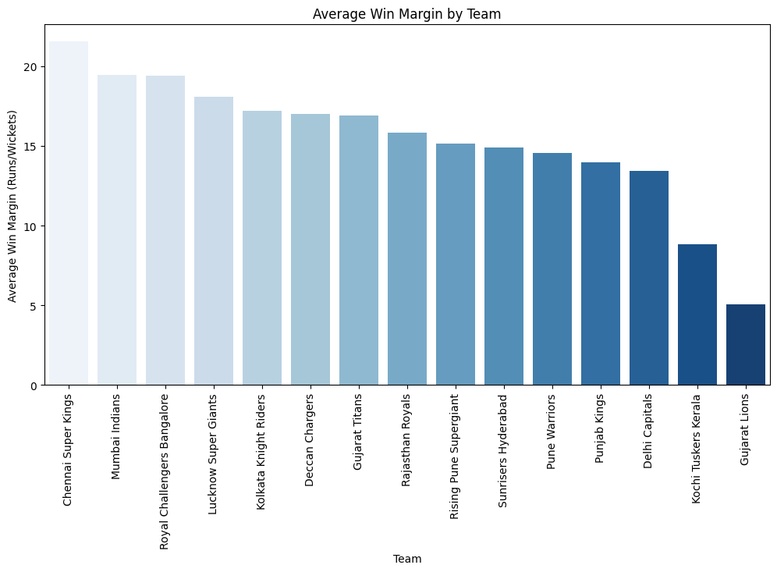
How does the win margin vary by team?

Slide 13
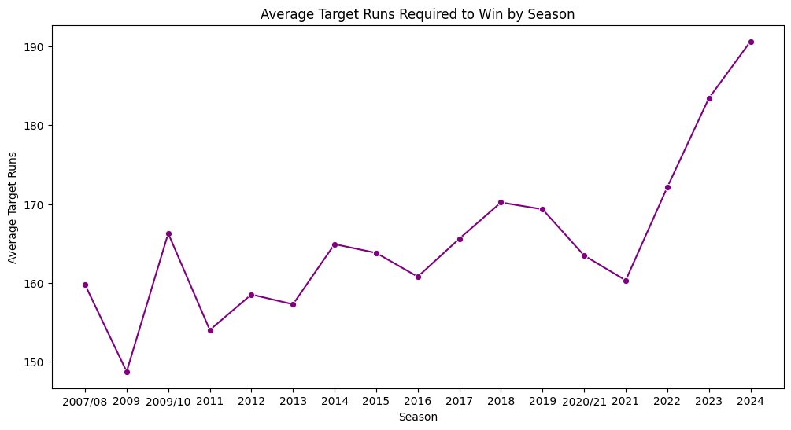
Has the average score required to win changed over the years?

Slide 14
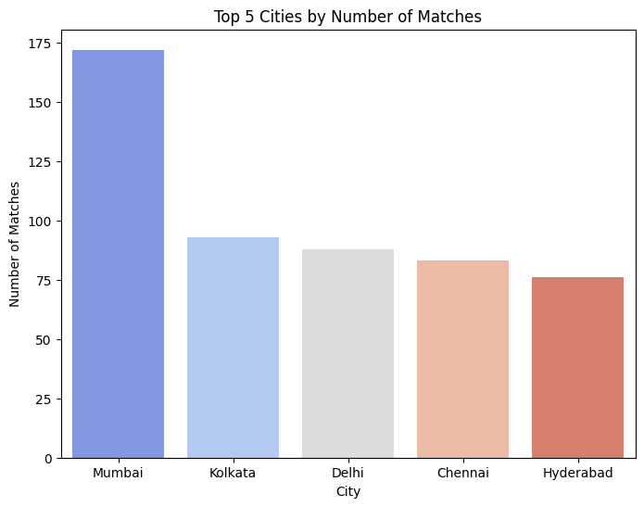
Top 5 Cities with the Most Matches?

Slide 15
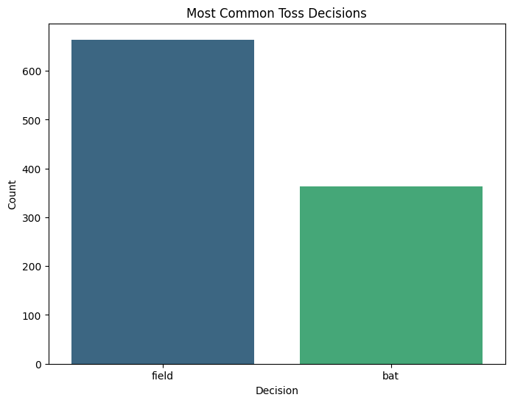
Most Common Toss Decisions?

Slide 16
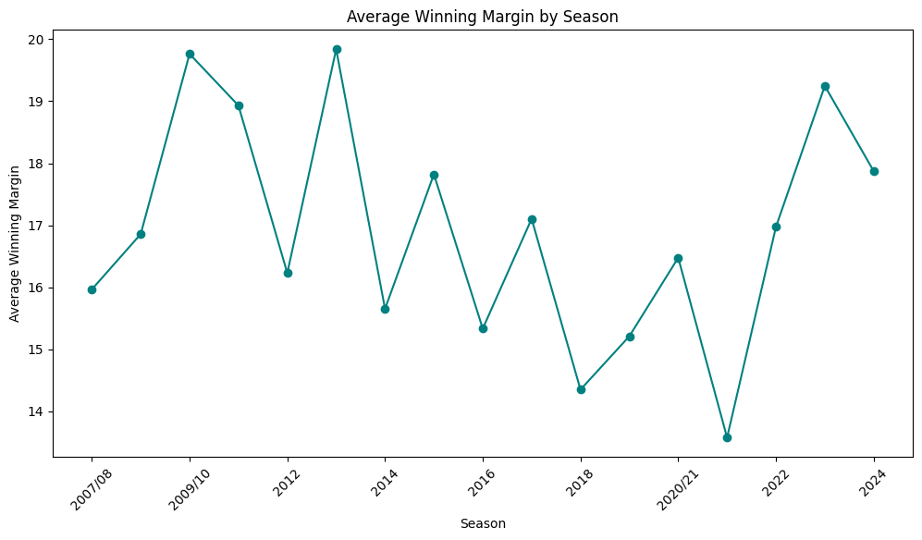
Winning Margins Over Time (Average per Season)

Slide 17
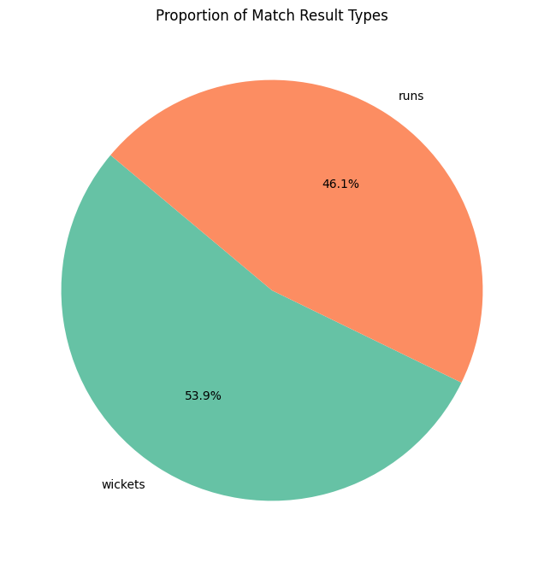
Most Common Match Result Types

Slide 18
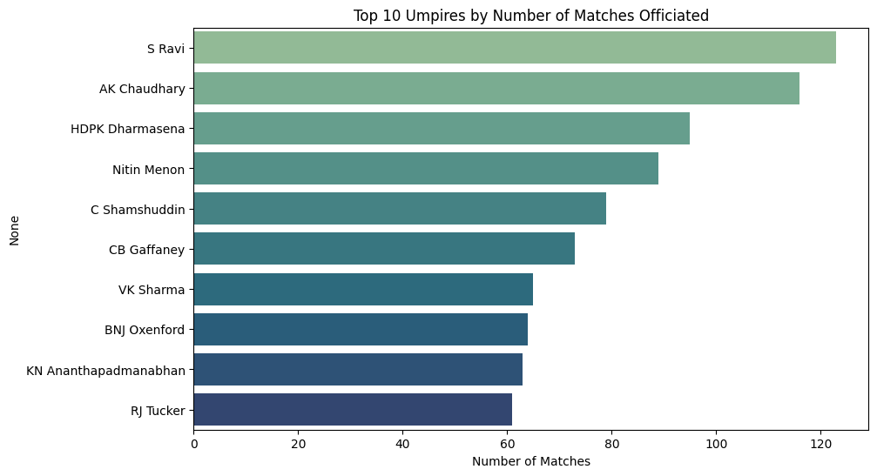
Top 10 Umpires with Most Matches Officiated

Slide 19
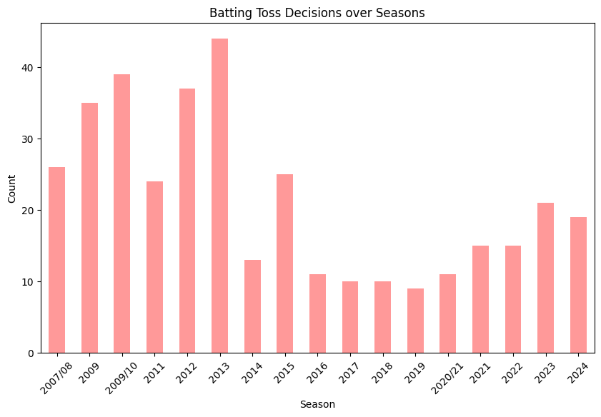
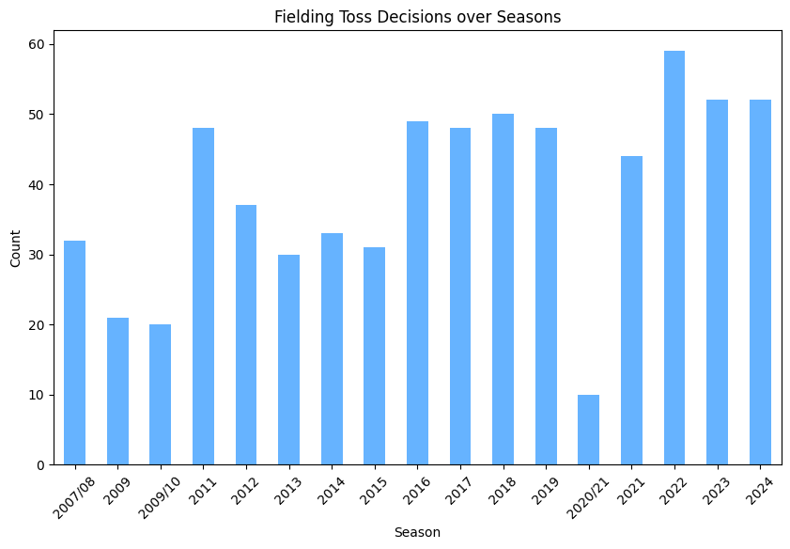
Comparison of Batting vs Fielding Decisions over Seasons

Slide 20
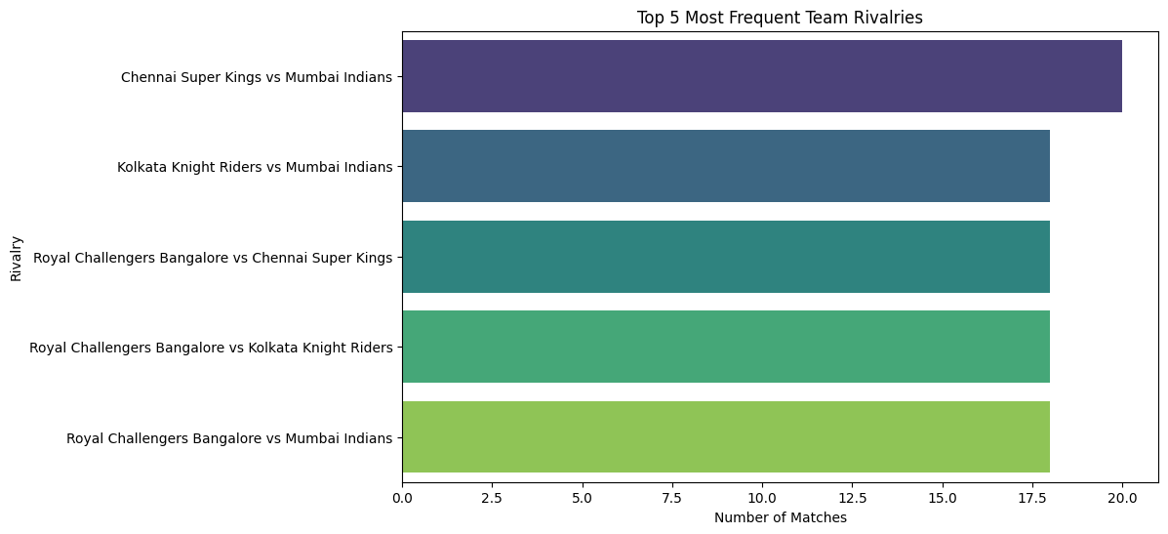
Top 5 Most Frequent Team Rivalries

Slide 21
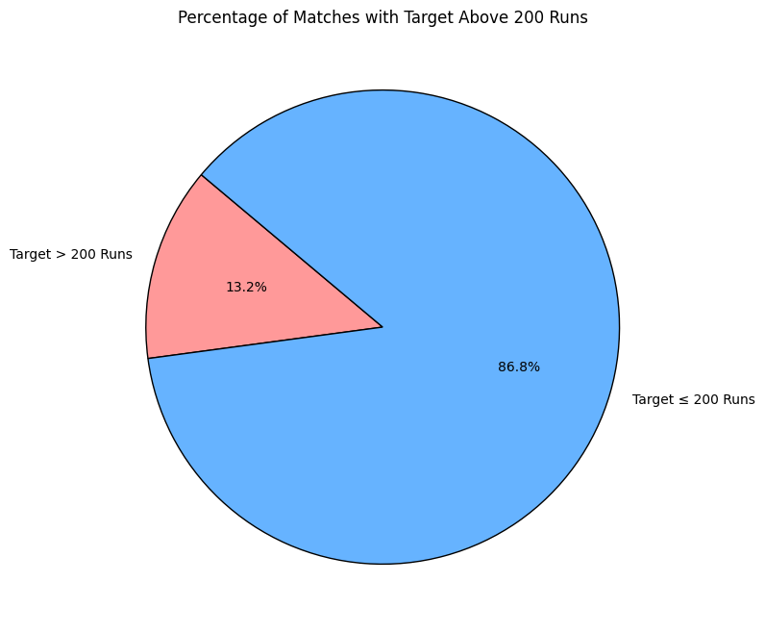
Percentage of Matches with Target Above 200 Runs

Slide 22
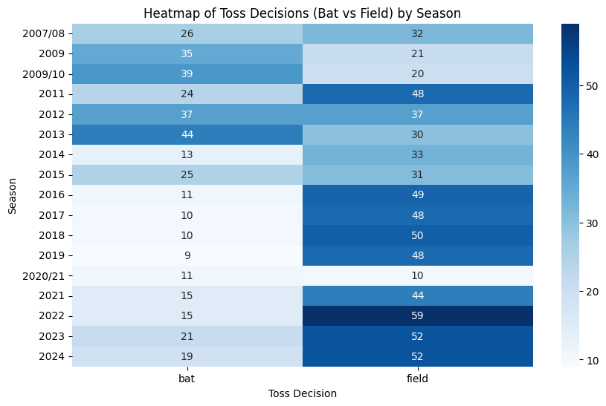
Toss Decision by Season

Slide 23
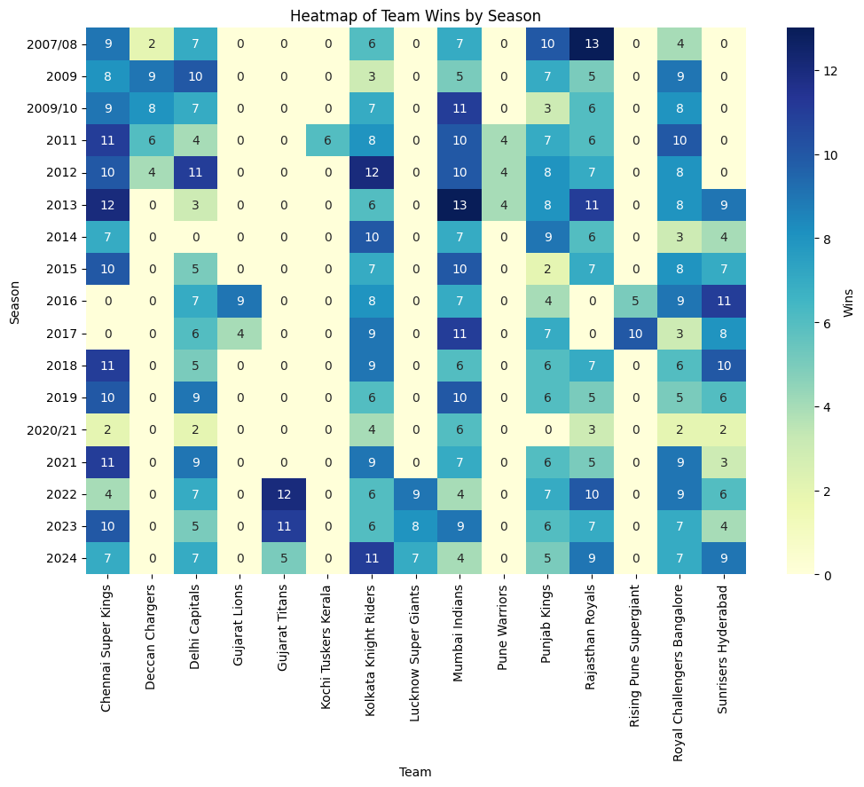
Match Outcomes by Team and Season

Slide 24
Advanced Analysis and Predictions
Predicting Match Winner Based on Team and Venue Information?
To predict the likely winner of an IPL match based on information such as the teams involved, the venue, and toss decisions.
Model Accuracy: 0.43
Predicting if Toss Decision Affects Match Outcome?
To determine if the decision made at the toss (bat or field) significantly influences the likelihood of winning the match.
Model Accuracy for Toss Impact: 0.50

Slide 25
Conclusion
This project aims to deliver valuable insights into factors affecting IPL match outcomes and individual performances, utilizing data analysis techniques. These insights could be beneficial for teams and analysts aiming to enhance strategic decision-making, team selection, and performance optimization in the IPL.

Slide 26
THANK YOU!

